Slide 1
Othello Design Presentation
Jordan White
Chandler Underwood
Taylor Spooner
Stephen Robinson

Slide 2
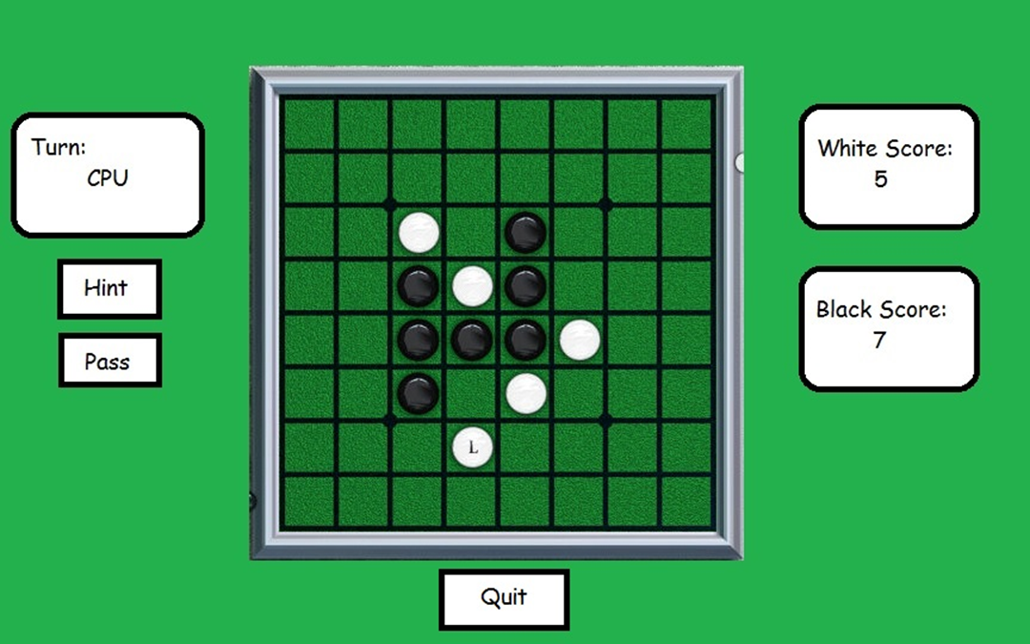
Requirements Recap

Slide 3
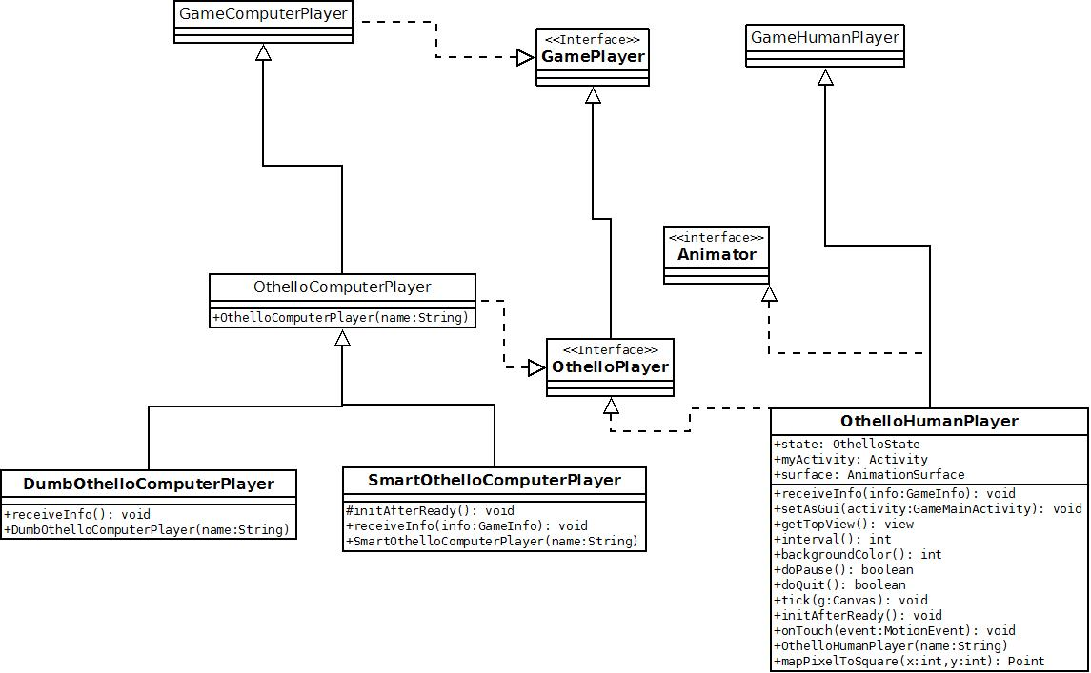
Class Diagram

Slide 4
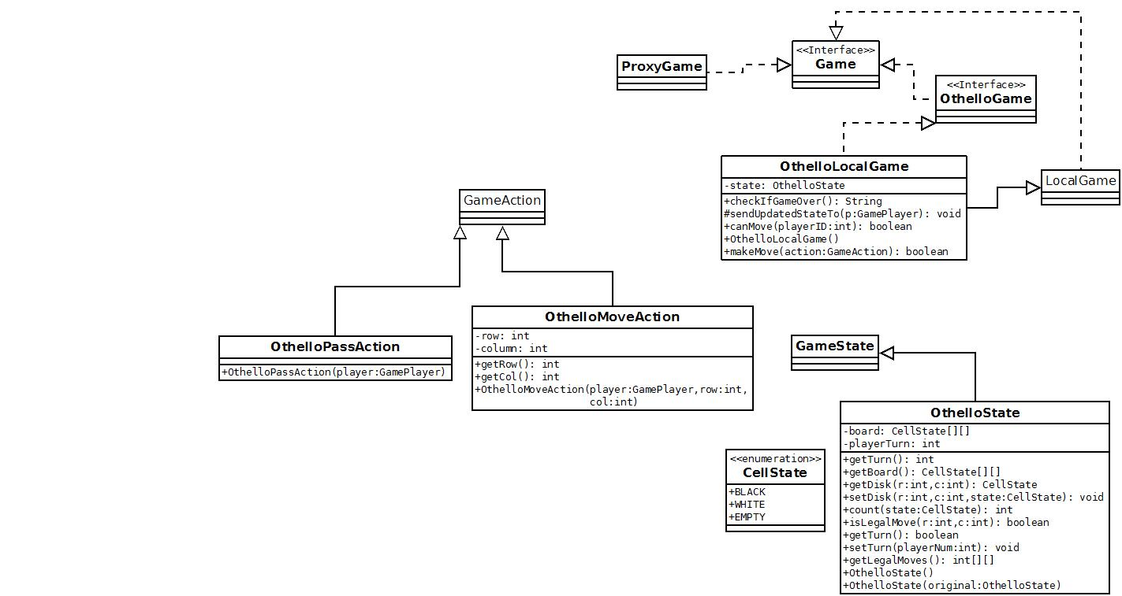
Class Diagram cont.

Slide 5
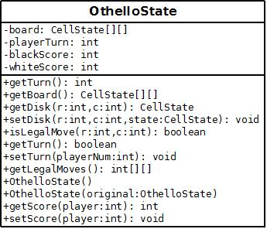
Othello State
A 8x8 array, type CellState (described on later slide) to represent the game board.
An int to keep track which player’s turn it is. Will always be 0 or 1.
Getter and setter methods to update the game board and tell who’s turn it is.
isLegalMove(int r, int c)
Parameters: A specific square on the game board designated by a row and column.
Checks to see if given square is a legal player for the player at turn.
Returns true if legal move, false if not.

Slide 6
Othello State cont.
The score for each player is stored in the whiteScore and blackScore instance variables.
Anytime the setDisc method is called, it will also call the setScore method for each player, updating the score.
There is a get legal moves method to quickly determine what places the ai can move to without guess and check.
We have a copy constructor that will send to the local game. This will prevent players from cheating.

Slide 7
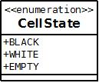
CellState
Enumeration used to describe each cell on the board.
Black: Black disc
White: White disc
Empty: No disc has been played yet.

Slide 8
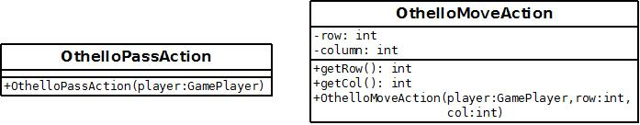
Othello Actions
OthelloMoveAction:
Has row and column instance variables.
When any player attempts to place a piece, a move action is created and sent to the Local Game which will determine via the state if it is legal or not and then make the move.
OthelloPassAction:
When any player cannot make a move, the ‘Pass’ button will get pressed, which creates a pass action. Tells the local game to switch the turn without updating the board.
Sequence diagram is shown on the next slide for a move action.

Slide 9
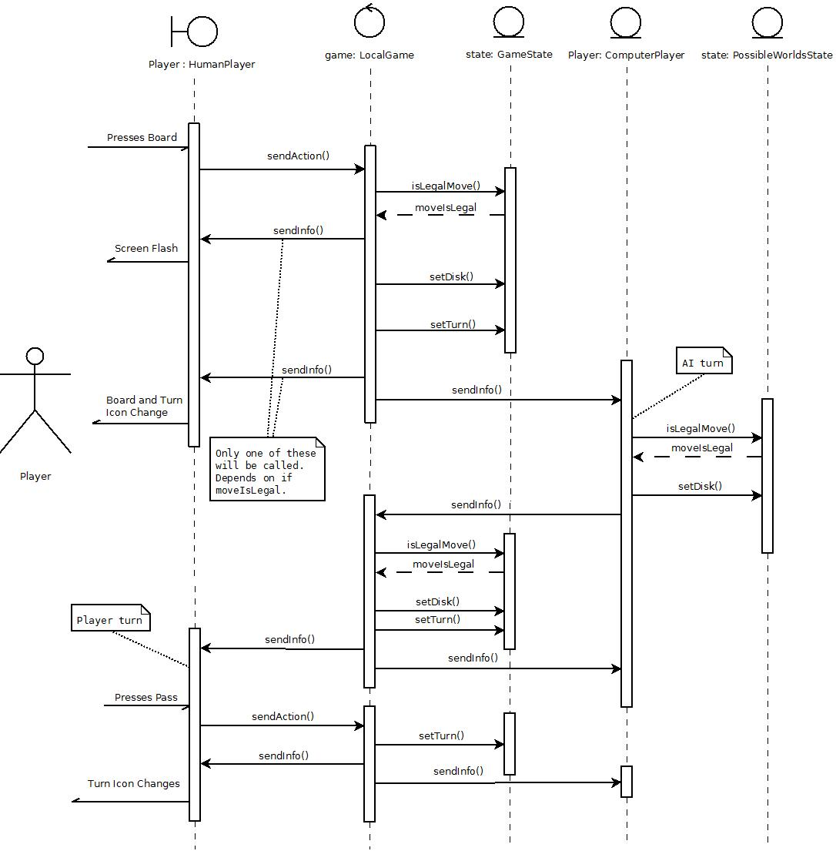

Slide 10
Dumb AI
No intelligence.
Randomly selects a move from the list of legal moves when it is its turn, or passes if unable to move.
Will have a short artificial delay before making its move.

Slide 11
Intelligent AI
Operates by examining game tree of possible worlds.
Creates a copy of the internal game state for each possible world, and maintains a record of the moves to get to that state for analysis.
It will look down each branch of the tree and quantify each possible path based on:
Points gained/lost
Corners and sides obtained
Estimated probability of occurrence, assuming player takes reasonable moves.
May include an artificial delay depending on the algorithm speed.

Slide 12
Project Plan
11/05: Finish design document. Update with feedback from lab.
11/08: The GUI will be created by Taylor and Chandler. The game state class will be done by Jordan. Early version of the human player will be created by Chandler and Taylor. This human player will be able to state the game and see the GUI but cannot interact. (12 hours per person)
11/12: All action classes and local game will be implemented by Jordan. The easy AI will be completed by Stephen. The human player will be completed by Chandler and Taylor.(8 hours person)
11/16: The smart AI will be completed by Stephen. Game should now be playable. (8 hours per person).
11/24: All bugs found in the Test-to-Succeed will be addressed and fixed. (Hours depending on where the bugs were found.)
12/5: All bugs found in the Test-to-Fail will be addressed and fixed. (Hours depending on where the bugs were found.)
12/6: Game completed and turned in.

